Slide 1
Build the Intelligent Bots using Microsoft Bot Framework and Cognitive Services
Eric ShangKuan
Sr. Technical Evangelist
Microsoft Taiwan

Slide 2
Agenda
Microsoft Bot Framework (MBF)
Understanding Human Languages
Integrated with Microsoft Bot Framework
Make Line bots work with MBF bots
Hands-on

Slide 3
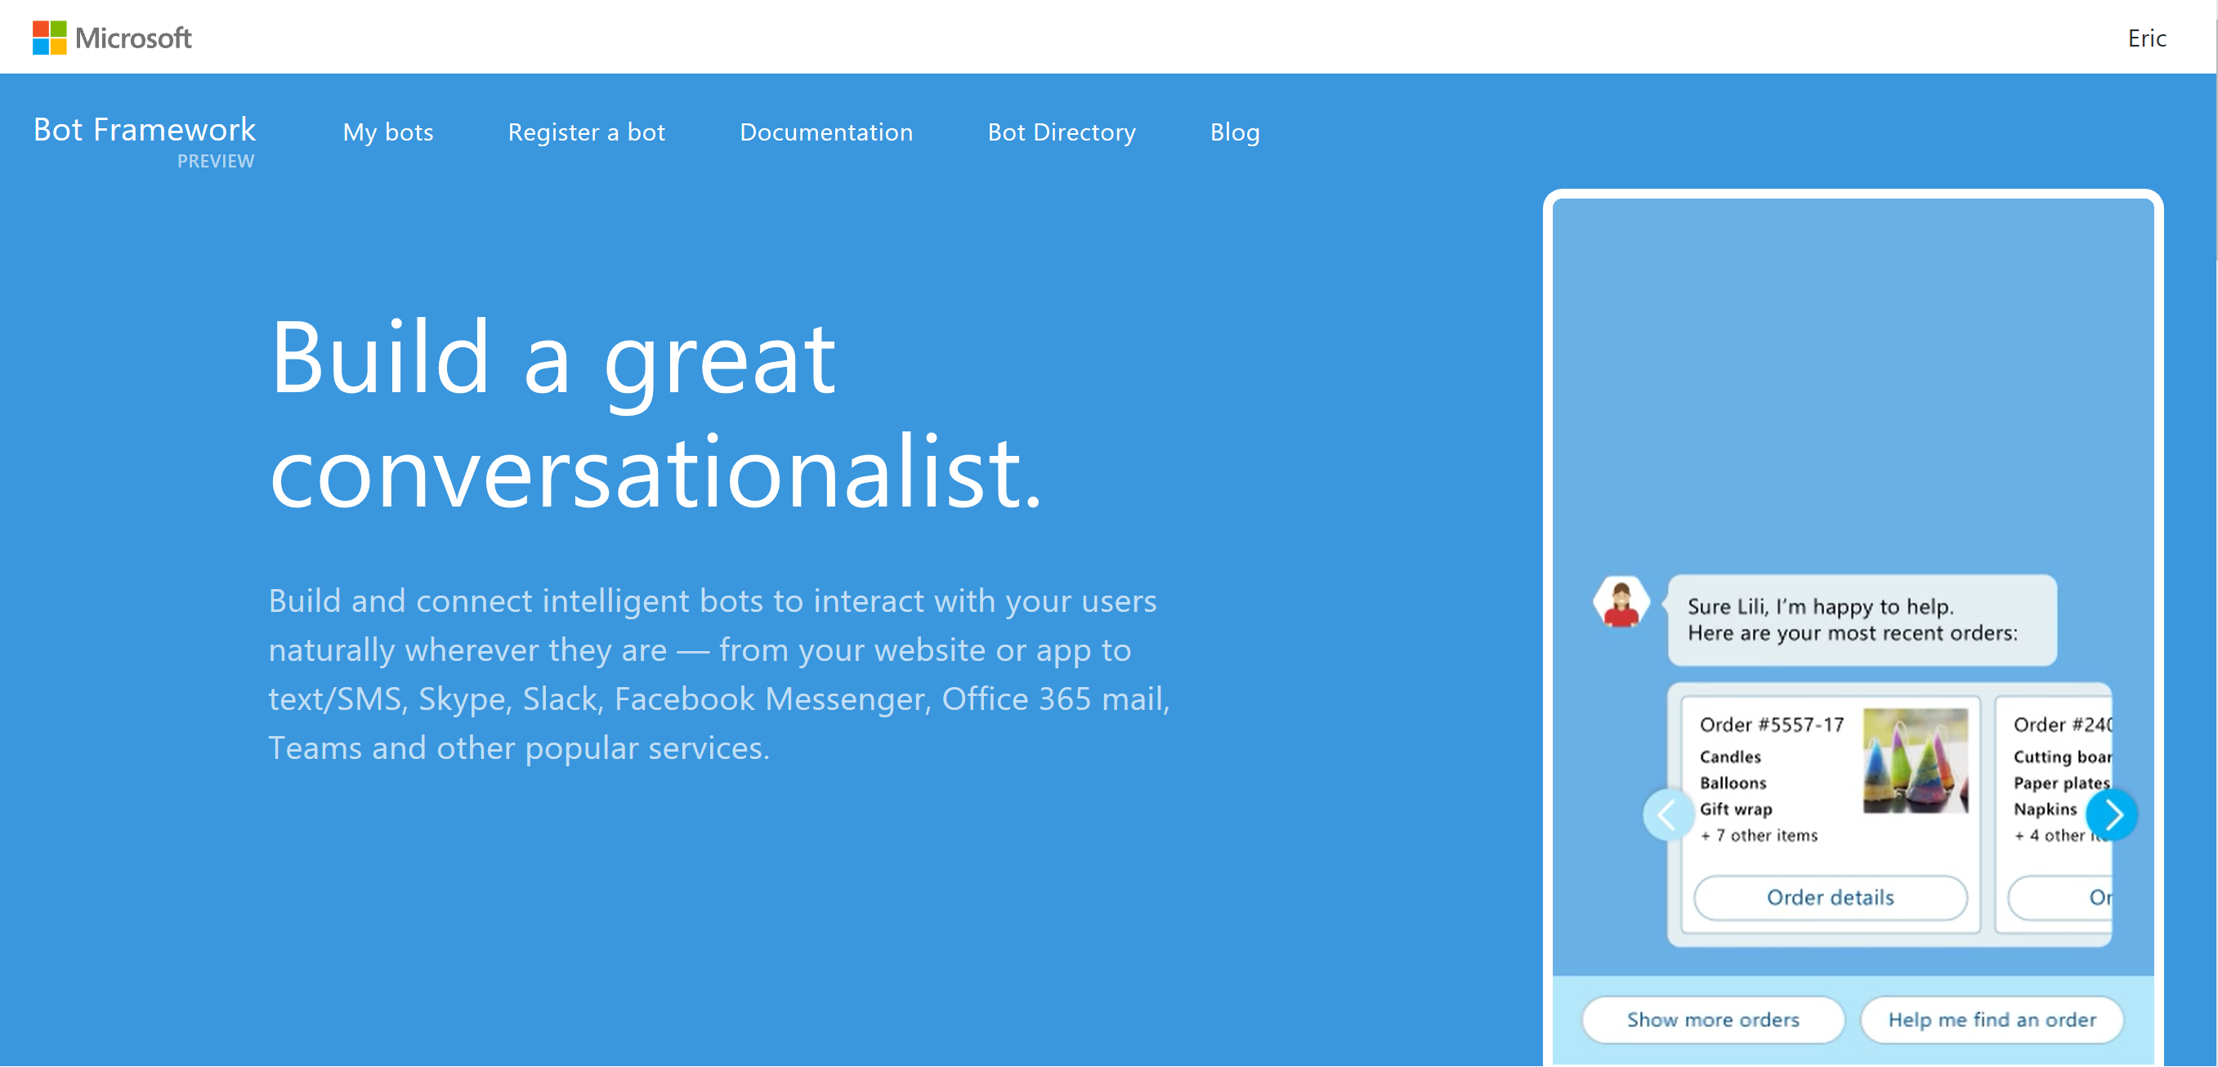
Microsoft Bot Framework

Slide 4
1990s: Internet
Search
User “visits” websites
The future: Conversations
Natural language between people and technology
Conversational canvas
Bots and agents
1980s: PC
Desktop
2000s: Mobile
Social
User download apps from App Stores

Slide 5
Human language is the new UI
People
Conversations as a Platform
Bots are the new apps; digital assistants are meta apps
Digital assistants
Bots
Intelligence infused into all interactions

Slide 6




Your Bot Framework
Bot Builder
Bot Connector
Bot Directory
Tools and services to build great bots that converse wherever your users are.
Connect your bots to text/sms, Skype, Slack, Facebook Messenger, Office 365 mail and other channels.
Try, user and add published bots to the world’s top conversation experiences
Open source SDK on Github for Node.js, .NET and REST
From simple built-in prompts and command dialogs to simple to use yet sophisticated ‘FormFlow’ dialogs
Support for rich attachments (image, card, video, doc, etc.); support for calling (Skype)
Online/offline chat Emulator
Add bot smarts with Cognitive Services for language understanding and more
Register, connect, publish and manage your bot through your bot’s dashboard
Automatic card normalization across channels
Skype channel auto-configured
Embeddable Web chat control
Host your bot in your app via the Direct Line API
Fast, scalable message routing
Bot Directory for discovery and trial
Public directory of bots registered and published with Microsoft Bot Framework
Users can try your bot from the directory via the Web Chat control
Users can discover and add your bot to the channels on which it is configured when the Directory is made public to end users

Slide 7
Your Bot..
C# or Node.js SDK
Builder & Connector included
Dialogs to model a conversation
Many types of dialog
Natural Language Understanding (LUIS)
Your Bot
Logic
Bot Builder SDK (Node.js / C#)
Web Service
LUIS

Slide 8
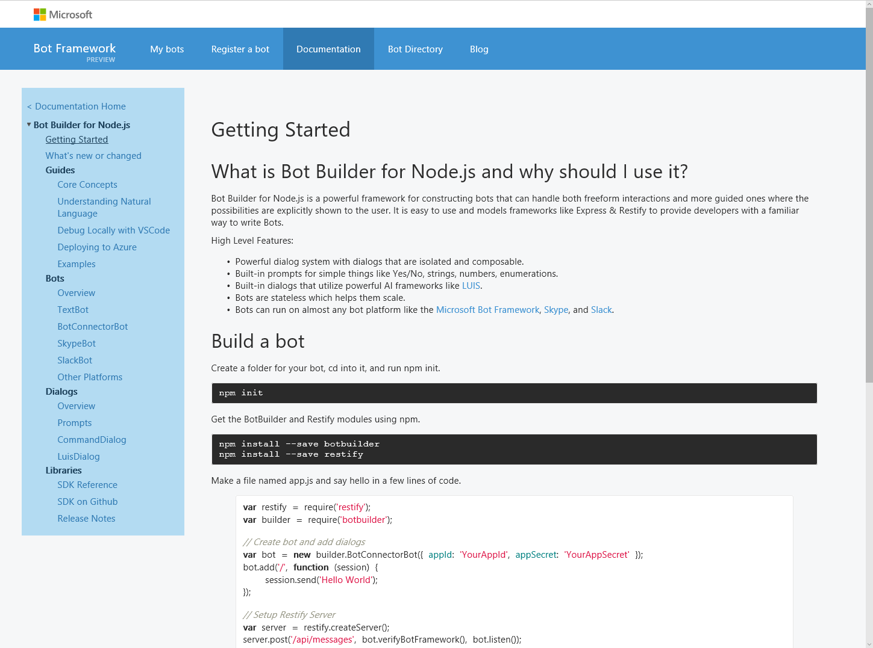
Bot Builder SDK
Node.js, .NET and REST
Dialogs to model conversation
Dialogs are reusable
Types of Dialogs include:
Built-in prompts
Yes/No, String, Number, Choices
FormFlow and form slot filling (branching, disambiguation, multi-turn)
Conversations are scalable to multiple machines
Rich interactions
Support for rich attachments (image, card, video, doc, etc.); support for calling (Skype)
Service extensions for language understanding (LUIS) and translation
Online/Offline Chat Emulator
Samples

Slide 9
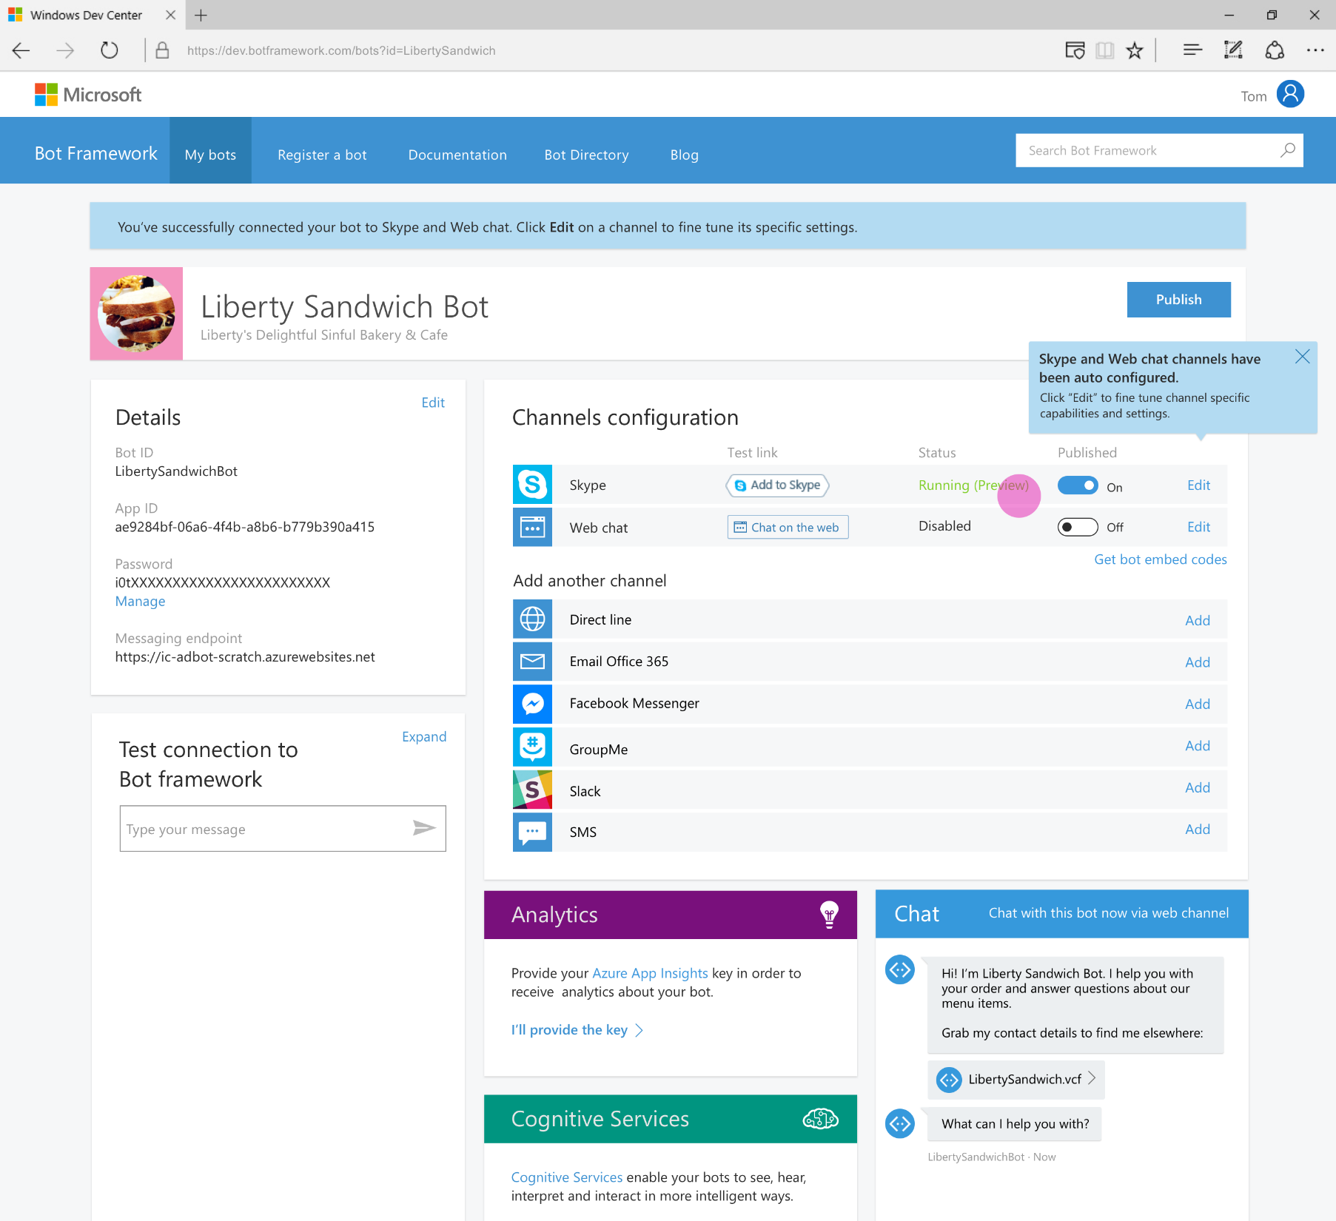
Developer Portal
Register your bot
Connect to channels
Test
Publish
Manage
Measure

Slide 10
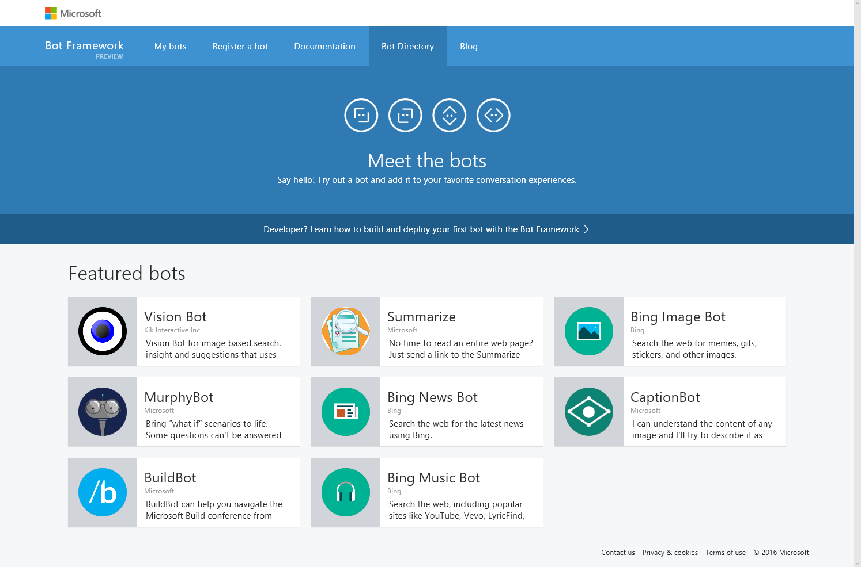
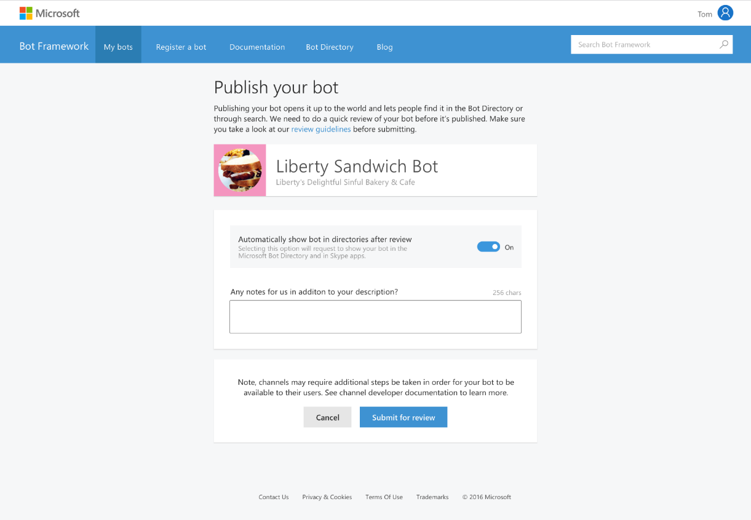
Bot Directory
Public Directory of Bot Framework Bots
Users can discover, try, and add bots to the conversation experiences on which the bot is configured (no app required)
Bots are public at developer discretion; bots must be submitted for review in order to appear in the directory
Searchable

Slide 11







Develop Bot…
Microsoft Account
SDKs
{ REST }
IDE / Test
Azure Bot Service
Bot Emulator
Visual Studio Code
Services
Cognitive Services
Developer Portal

Slide 12
Demo
Bot Framework

Slide 13



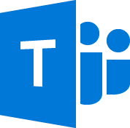

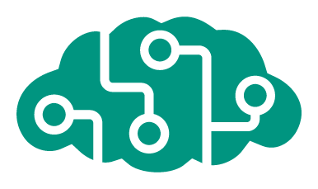







Azure Bot Service Preview
Accelerate development cycles
Enrich your bots
Boost operational efficiencies
</>
Powered by Azure Functions
Continuous deployment
Develop your way
Built in code editor
Channel support
Cognitive Services
API
Quick start templates
Integrated chat window
Direct Line support
Embedded web chat
Scale on demand
Reduced dev ops

Slide 14
Demo
Azure Bot Services

Slide 15

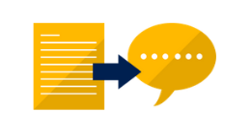
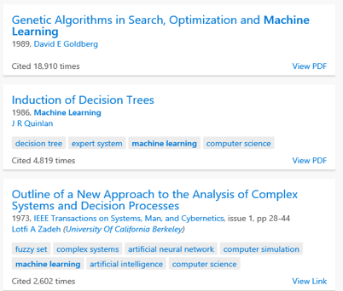

Microsoft Cognitive Services
Vision
Speech
Language
Knowledge
Search
PlayEpisode
What is in the image?
Give me directions to El Gaucho
Play today’s Daily Show
Top publications in AI?
Search for ‘cute kittens’
Computer Vision
Speech-to-Text and Text-to-Speech Service
Natural Language Processing
Knowledge Exploration Service
Bing Search
Here are the top results:
Here is what I found:
Intent: PlayEpisode
Content: Daily Show
DateTime.date: today
Category | People; 1 face
Adult / Racy? | False / True
Dominant colors
Accent color
Convert text to spoken audio
Convert spoken audio to text
Extract intent of user
Notes:
Vision
Computer Vision API: Distill actionable information from images
Emotion API: Personalize experiences with emotion recognition
Face API: Detect, identify, analyze, organize, and tag faces in photos
Video API: Analyze, edit, and process videos within your app
Speech
Bing Speech API: Convert speech to text and back again, and understand its intent
Custom Recognition Intelligent Service (CRIS): Fine-tune speech recognition for anyone, anywhere
Speaker Recognition API: Give your app the ability to know who’s talking
Language:
Bing Spell Check API: Detect and correct spelling mistakes within your app
Language Understanding Intelligent Service (LUIS): Teach your apps to understand commands from your users
Linguistic Analysis API: Easily parse complex text with language analysis
Text Analytics API: Detect sentiment, key phrases, topics, and language from your text
Web Language Model API: Leverage the power of language models trained on web-scale data
Knowledge
Academic Knowledge API: Explore relationships among academic papers, journals, and authors
Entity Linking Intelligence Service: Contextually extend knowledge of people, locations, and events
Knowledge Exploration Service: Add interactive search over structured data to your project
Recommendations API: Provide personalized product recommendations for your customers
Search:
Bing Autosuggest API: Give your app intelligent autosuggest options for searches
Bing Image Search API: Bing advanced image and metadata search to your app.
Bing News Search API: Link your users to robust and timeline news searches
Bing Video Search API: Trending videos, detailed metadata, and rich results
Bing Web Search: Connect powerful search to your apps

Slide 16
Language Understanding (LUIS)
Read me the headlines
Intent: TextToSpeech
Content: headlines
Determine intent and detects entities
Seamless integration with Speech Recognition
Learns over time
Use pre-built, world class models from Bing and Cortana
Models work across devices
Play yesterday’s Daily Show
Intent: PlayEpisode
Content: Daily Show
DateTime.date: T-1 Day
Pause for 5 minutes
Intent: PauseDevice
DateTime.duration: 5 Minutes
Notes:
LUIS helps you understand what your users are saying (e.g. “turn on the lights,” “news about flight delays”)
Determines intent and detects entities
Seamless integration with Speech Recognition
LUIS learns over time
Uses pre-built, world class models from Bing and Cortana
Models work across devices (phone, tablet or other Internet connected device)
For media, this might work like this:
“read me the headlines”
Intent: TextToSpeech
Content: NewsHeadlines
“play last night’s Tonight Show”
Intent: PlayEpisode
Content: TonightShow
Date: T-1Day
“pause for 5 minutes”
Intent: PauseDevice
Device: MediaPlayer
DateTime.duration: “5M”

Slide 17
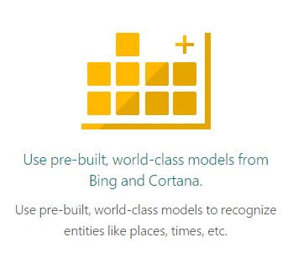
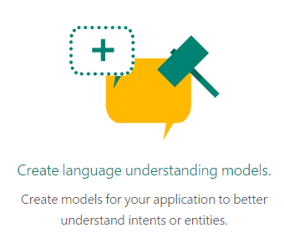
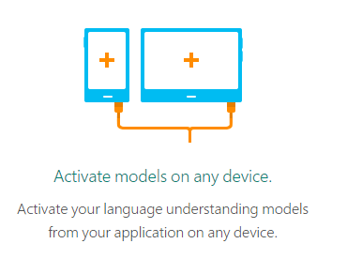
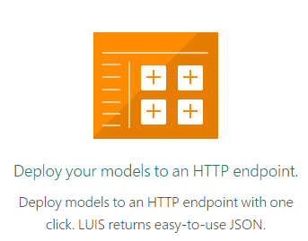
Who is Luis !!?
Language understanding intelligent Service

Slide 18
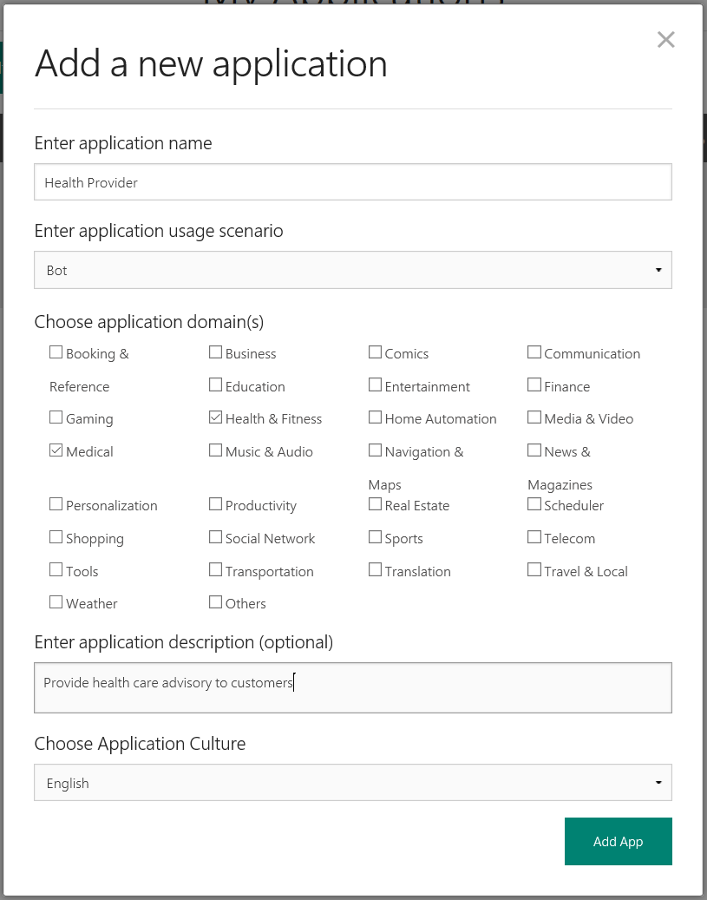
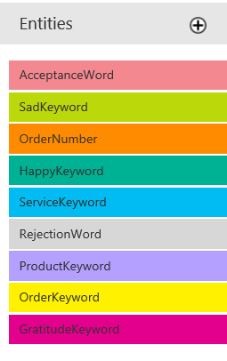
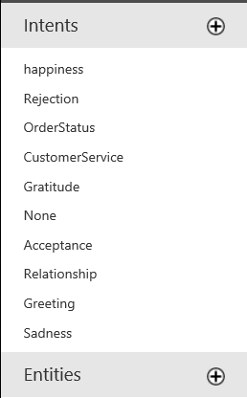
Create your own Luis … App!
1
3
2

Slide 19
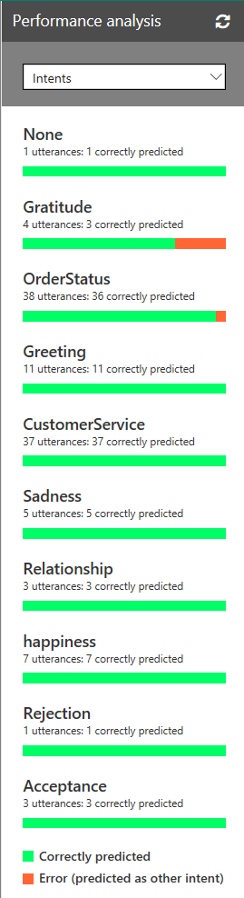
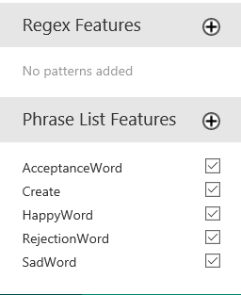
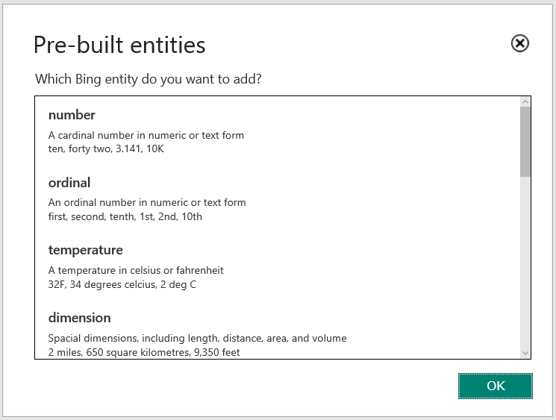
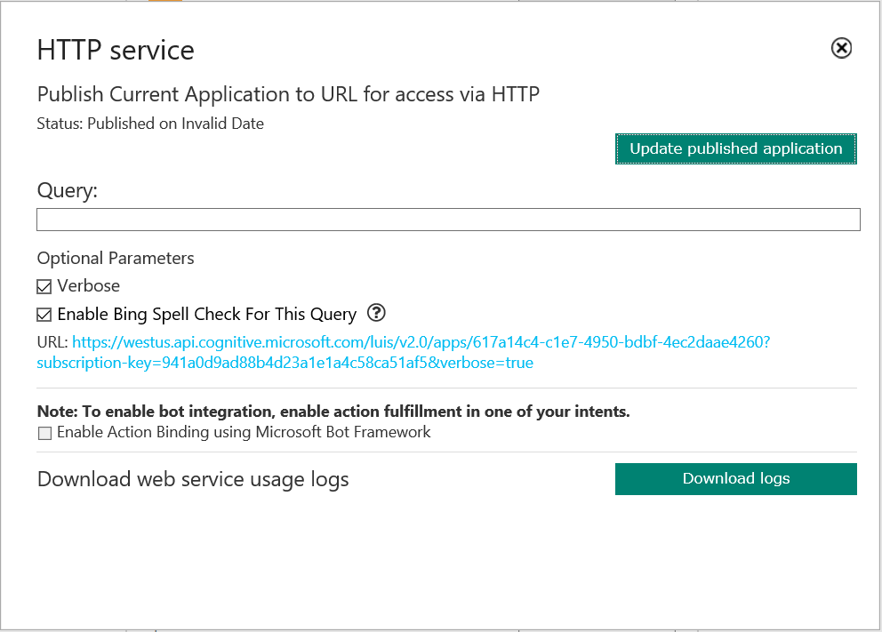
Optimize, train & publish your App
Publish
Optimize

Slide 20
Demo
LUIS Portal

Slide 21
Direct Line Channel

Slide 22
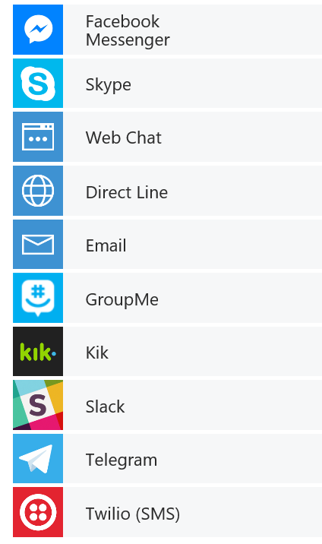


Direct Line Channel
channels
Humans
Your Bot – A web service
Channel
https://directline.botframework.com
MS Bot Connector -
Routes Messages, Manages State, Bot Registration, Directory, Storage, APIs etc.

Slide 23
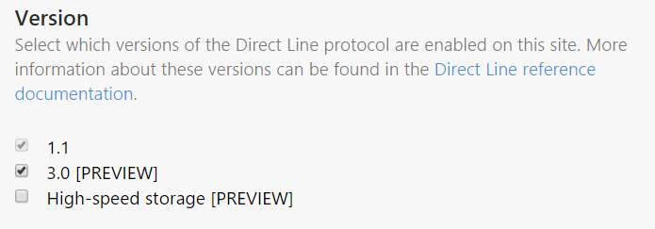
Direct Line API
Direct Line 1.1 & Direct Line 3.0 – REST API (recommend for new clients)
An authentication mechanism using standard secret/token patterns
The ability to send messages from your client to your bot via an HTTP POST message
The ability to receive messages by Web Socket stream, if you choose ( only in V3.0)
The ability to receive messages by polling HTTP GET, if you choose
A stable schema, even if your bot changes its protocol version
Also , available as NuGet, Microsoft.Bot.Connector.DirectLine

Slide 24
How it works ?
POST /v3/directline/conversations
https://directline.botframework.com
HTTP/1.1 201, Conversation ID, Token, StreamUrl, Expiry
Client App
Bot
MSA/ AAD - Auth
Bot Connector
POST /v3/directline/conversations/{convID}/activities
Bot Connector API
"type": "message"
HTTP/1.1 200 Activity Id
Bot State API
GET /v3/directline/conversations/abc123/activities?watermark=003a
{MicrosoftAppId} &
{MicrosoftAppPassword}
POST /v3/directline/conversations/{convID}/activities
"type": “endOfConversation"

Slide 25
Demo
Bot w/ Direct Line Channel

Slide 26
Hands-on!

